Slide 1



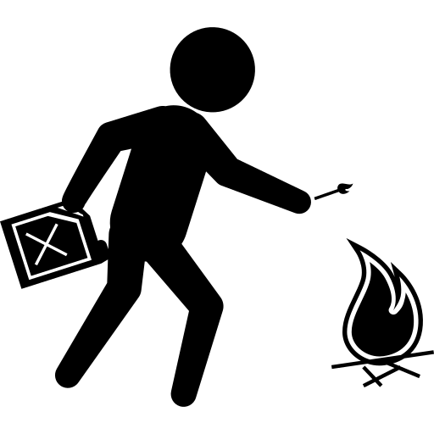

Hate crimes in india
Presented by:
Akhil Arasada
Puppala Uday Bhaskar

Slide 2
Hate crimes
A crime , typically one involving violence , that is motivated by prejudice on the basis of race ,religion, sexual orientation , or other grounds.

Slide 3
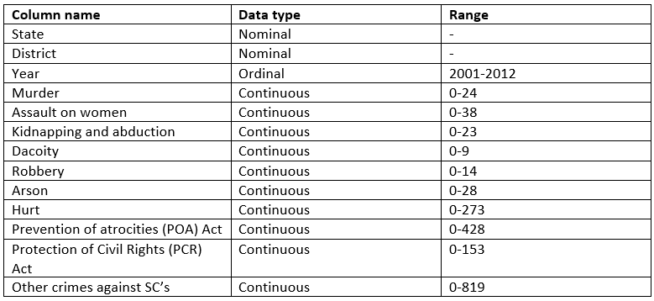
Data Description
The hate crimes dataset has 9385 rows and 13 columns.

Slide 4
Data Description (contd.)
The literacy rate and state wise GDP tables have been extracted using pandas from the Wikipedia pages.
Literacy rates table is 37 rows and 4 columns.
State wise GDP table is 33 rows only as the GDP hasn’t been recorded for certain union territories.

Slide 5
Sources for the data
Data has been picked from the National Crime Record Bureau of india .
Literacy rates have been taken from Wikipedia- (https://en.wikipedia.org/wiki/List_of_Indian_states_and_union_territories_by_literacy_rate).
State wise GDP has been taken from- https://en.wikipedia.org/wiki/List_of_Indian_states_and_union_territories_by_GDP_per_capita
Time period : 2001 to 2012
Geography : India
Analysis : Hate crimes in India against members of scheduled castes

Slide 6
Problem Statement
To see if one can make inferences from our data based off of the geography, literacy rates and the economic conditions of the states, over a time span of 12 years.

Slide 7
Chapter 1 To understand which crimes have chances of occurring together
5

Slide 8
Chapter 1
Here, we tried to understand if certain crimes had degrees of correlation and see if these could be grouped together as serious offences or not.
For this purpose we used the seaborn cluster map and annotations to better understand our data.

Slide 9
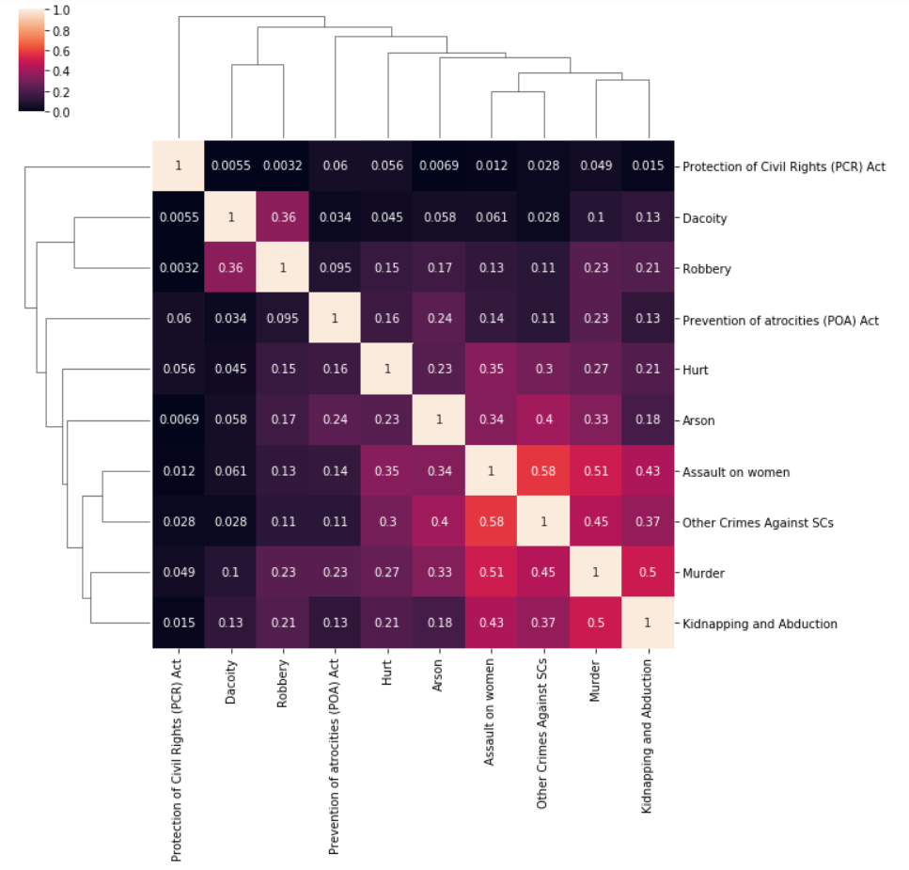

Slide 10
Chapter 2 To identify the most dangerous and safest places for the reserved classes

Slide 11
Chapter 2
We made use of tableau to identify the states with the highest number of crimes incident against the reserved classes.
We did this by summing all the crimes that had occurred from 2001 through 2012.

Slide 12
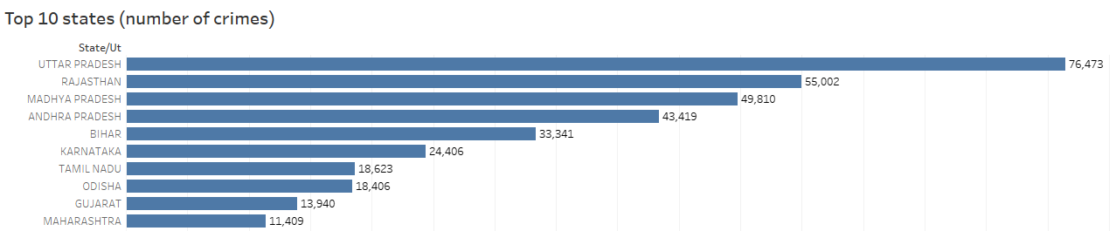
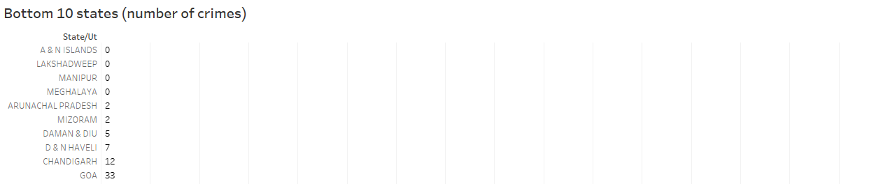

Slide 13
Chapter 3 To look at the data geographically and make inferences

Slide 14

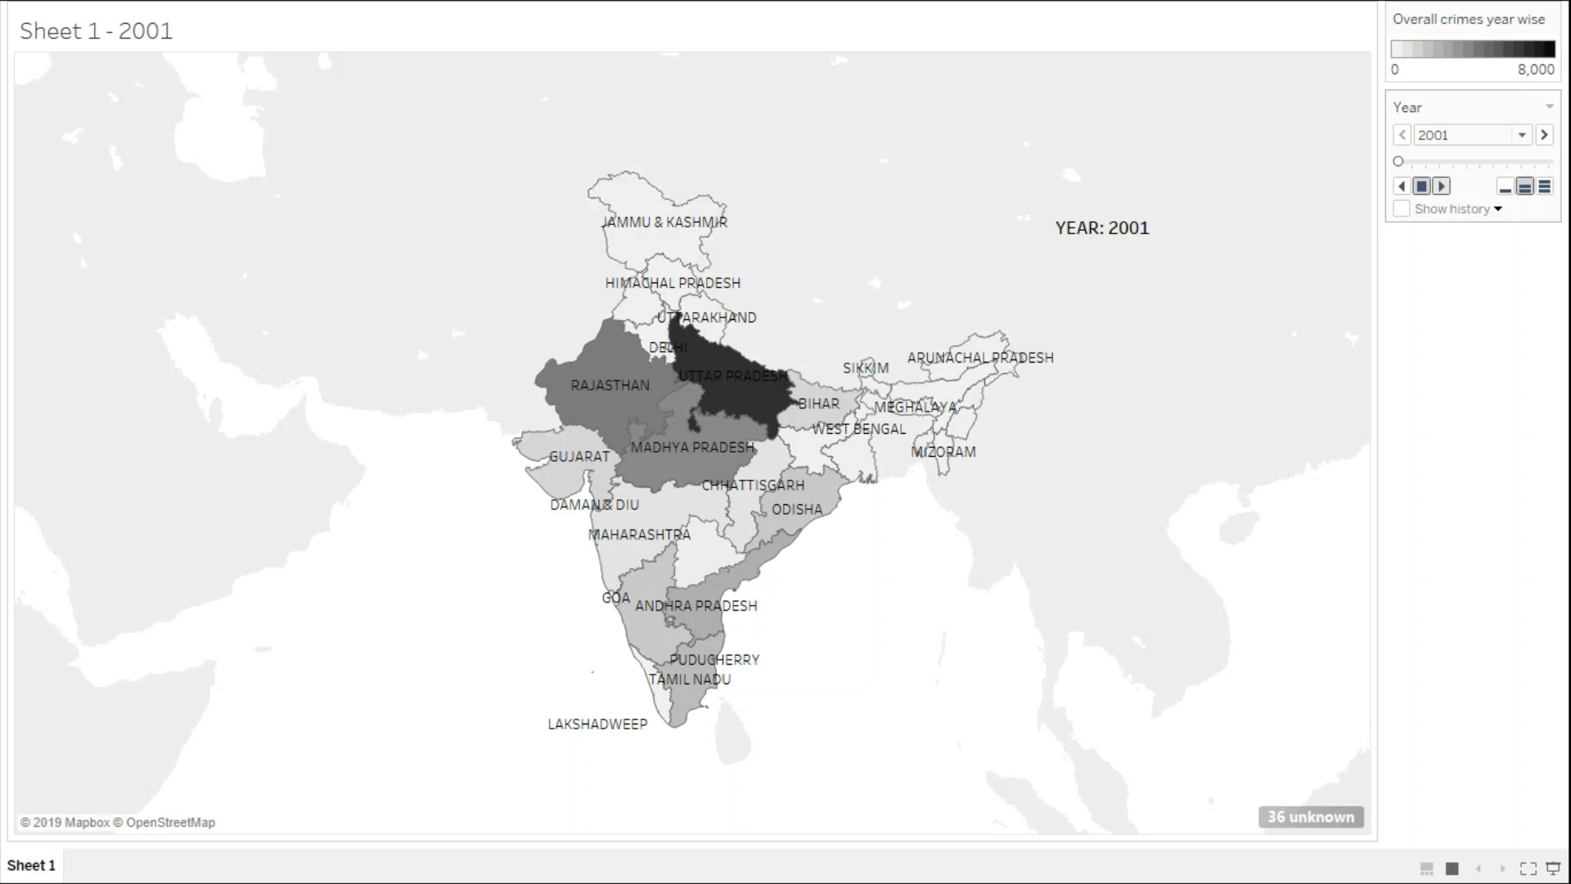

Slide 15
Chapter 4 To find if any association exists between the literacy rate and hate crimes incident

Slide 16
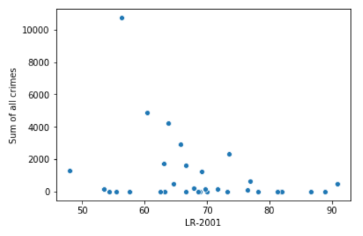
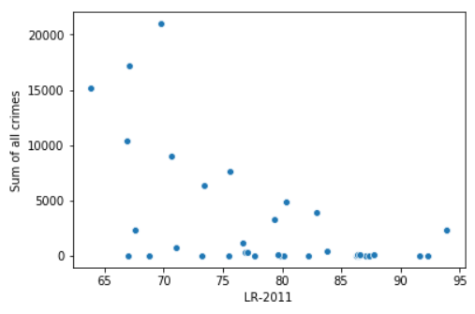
Chapter 4
We pulled the literacy rate data from Wikipedia and used pandas merge method to form the consolidated dataset.
The data was available only from the census conducted in 2001 and 2011.

Slide 17
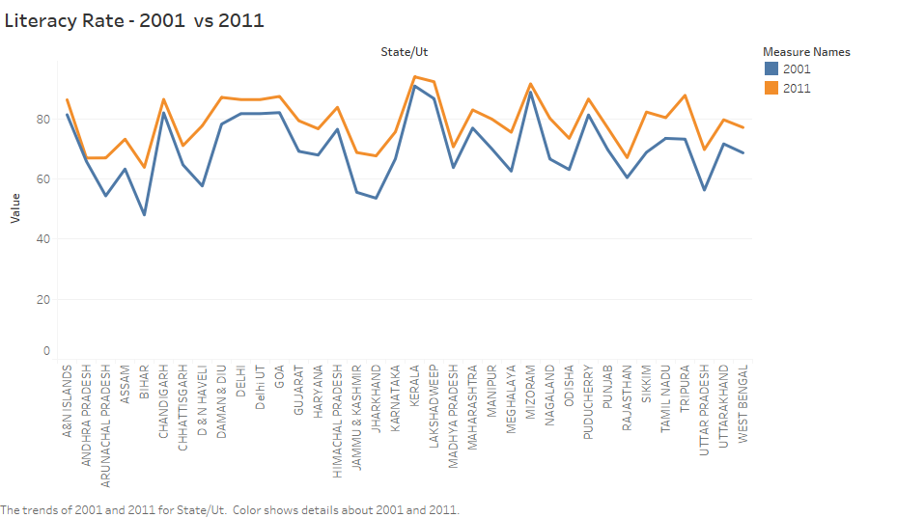

Slide 18
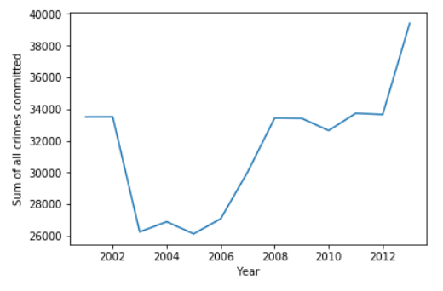
Our hypothesis that the increase in literacy rate is associated with a decrease in hate crimes has been proved wrong. Though there has been a decrease in crimes till 2006, a rapid increase has been observed over the latter years.

Slide 19
Chapter 5 To find if any association exists between the States’ GDP and number of hate crimes in it.

Slide 20
Chapter 5
The data was consolidated as mentioned in chapter 4. Weak correlation was found using the pandas heatmap.
We also used tableau and represented the GDP vs. total number of murders for the year 2001 and 2011. All the other years has close resemblances to these two.

Slide 21
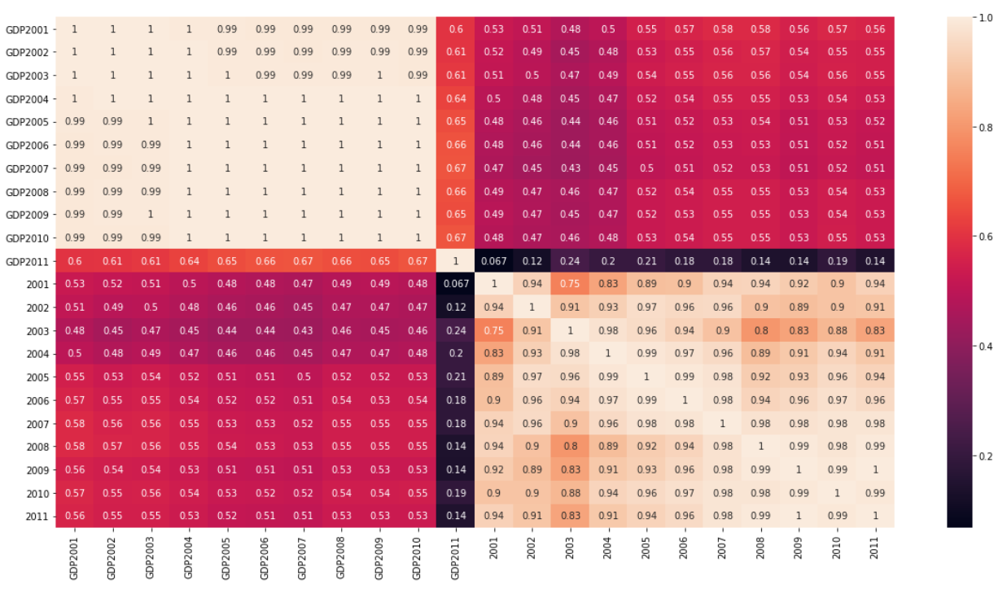

Slide 22
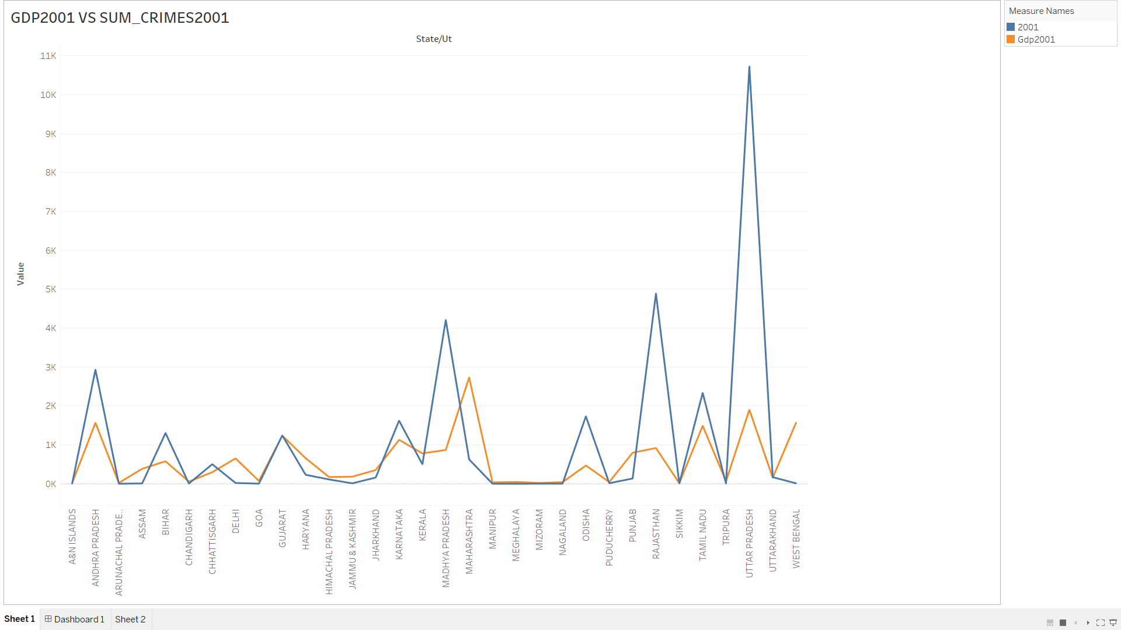

Slide 23
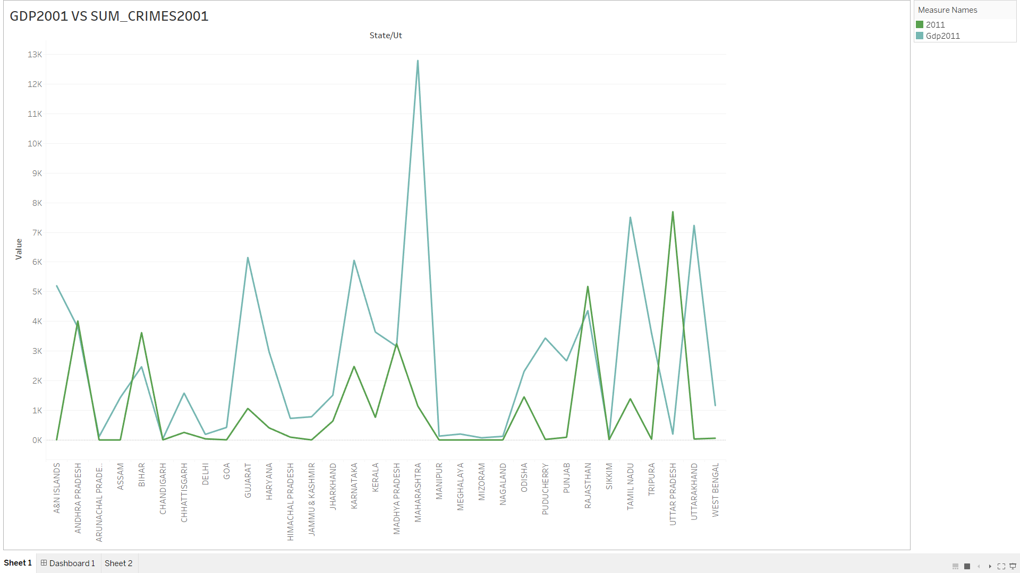

Slide 24
Conclusions and inferences
Certain crimes are moderately correlated and thus have high chances of occurring together. Those crimes were- assault on women, kidnapping and abduction and murder.
The most dangerous and safest places for the reserved classes were identified. Law enforcement should enact stricter policies for offences in the most dangerous regions
North-middle India had the highest prevalence of hate crimes. Education of the masses is not necessarily correlated with a decrease in hate crimes. Other variables are also at play.
The association between a states’ economic condition and hate crimes is worrisome as it is indicative of a relation between the crimes and the economic gap between the masses.

Slide 25
thanks!
Any questions?

